Slide 1

Face Anti-Spoofing Using Deep Learning
by
Jashwanth Kumar.S
Roll No. 184G1A0524
Naveen Kumar.P
Roll No. 184G1A0553
Ankitha.P
Roll No. 184G1A0502
Komala.M
Roll No. 184G1A0531
Under the guidance of
Dr.G.K.Venkata Narasimha Reddy _{M.Tech.,Ph.D}
Professor
Department of Computer Science and Engineering
Srinivasa Ramanujan Institute of Technology
(Affiliated to JNTUA & Approved by AICTE) (Accredited by NAAC with ‘A’ Grade & Accredited by NBA (EEE, ECE & CSE)
Rotarypuram Village, B K Samudram Mandal, Ananthapuramu – 515701.
2021 - 2022

Slide 2
Abstract
Face recognition has been widely researched and achieved great success in a variety of applications because the human face saves the most extravagant data for perceiving people. Face spoofing attacks continue to pose a threat to modern face recognition systems. Recent researchers had proposed their research in this area but many existing methods for face anti spoofing have been degraded by illuminations.
We propose a novel framework based on the Convolutional Neural Network for the face anti-spoofing problem, which is inspired by the philosophy used by humans to determine whether a presented face example is genuine or not. Specifically, we use deep learning to mimic the behavior of discovering face-spoofing-related information from image sub-patches.

Slide 3
Review 0 Remarks
In review 0,our project was clashed with others.
So, we came up with new title“ Face Anti-Spoofing Using Deep Learning” .

Slide 4
Review 1,2 Remarks
In review 1,2 we didn’t come up with the accurate results to detect deep fake.
So we decided to work with spoofed images and have considered to develop a model to classify the images as spoofed or real.

Slide 5

Contents
Introduction
Existing System
Proposed System
Literature Survey
Problem Definition
Planning
Requirements
Design
Implementation
Conclusion
References

Slide 6
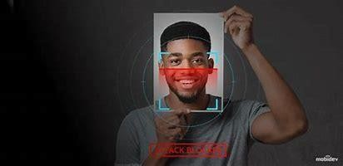
Introduction
The biometric systems are widely used in real-world applications including mobile phone authentication and access control, biometric spoof, or Presentation Attack (PA) are becoming a larger threat, where a spoofed biometric sample is presented to the biometric system and attempted to be authenticated.
Face is the most accessible biometric modality, there have been many different types of presentation attacks for faces including print attack, 3D masks, etc.
In order to develop a face recognition system that is invulnerable to various types of PAs, there is an increasing demand on designing a robust face anti-spoofing system to classify a face sample as real or spoof.

Slide 7
Existing System
Effective Face Anti-Spoofing (FAS) approaches are greatly desired and required for the development of safe face recognition systems.
Traditionally various techniques have been proposed to extract handcrafted features with image descriptors as representations.
These features are usually used to train a Support Vector Machine (SVM) to classify genuine or spoofing examples and these features are insufficiently discriminative.
Deep-learning-based strategies have recently demonstrated to be more effective than standard methods in countering spoofing attacks.

Slide 8
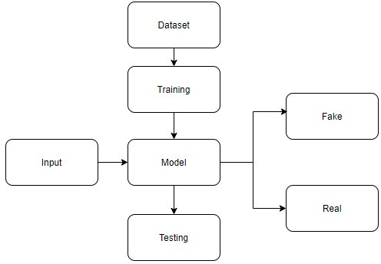
Proposed System
To overcome the drawback of existing system, we propose a novel framework based on the Convolutional Neural Network for the face anti-spoofing problem.
The proposed model is used for dealing with images, work efficiently and have more accuracy.

Slide 9
Problem Definition
Face recognition biometrics is now widely employed. Face recognition software should be able to recognize not only people's faces, but also spoofing attempts using printed faces or digital presentations.
Support Vector Machine (SVM) to classify genuine or spoofing examples and these insufficiently discriminative.
The overall objective of our model is to identify the fake faces, which are spoofed and address them to avoid illegal activities. In our model, we are using Convolutional Neural Network (CNN).
The predicted results can be used to predict the face as ‘Fake’ or ‘Real’.

Slide 10
Literature Survey
[1] [H. Li, W. Li, H. Cao, S. Wang, F. Huang, and A. C. Kot]:They proposed that automate the detection of for face anti-spoofing using unsupervised learning algorithms. The outcome is Automate the detection of for face anti-spoofing using unsupervised learning algorithms.
[2] [R. Nosaka, Y. Ohkawa, and K. Fukui]:The Feature extraction based on co-occurrence of adjacent local binary patterns. The conventional LBP-based features as represented by the LBP histogram still have room for performance improvements. In particular, expression ability for a given image can be improved, since all LBPs are simply summed into a single histogram, thereby discarding spatial relations among the LBPs and the rich image information they contain. To improve their performance, we introduced the extension of original LBP by considering the co-occurrence of adjacent LBPs, measuring co-occurrence with an auto-correlation matrix generated from multiple LBPs.

Slide 11
Contd...
[3] [I.Chingovska, A.Anjos and S. Marcel]: Spooﬁng attacks are one of the security traits that biometric recognition systems are proven to be vulnerable to. When spoofed, a biometric recognition systems bypassed by presenting a copy of the biometric evidence of a valid user. Among all biometric modalities, spoofing a face recognition system is particularly easy to perform. In particular, we inspect the potential of texture features based on Local Binary Patterns (LBP) and their variations of attacks: printed photographs, and photos and videos displayed on electronic screens of different sizes.

Slide 12
Planning
WEEKS | TASK
WEEK 1 | Downloading and installing the software
WEEK 2 | Data cleaning and preparation on dataset
WEEK 3 | Develop a model using CNN
WEEK 4 | Testing and producing the results and its documentation
WEEK 5 | Report generation and document submission

Slide 13
Requirements :
Hardware Requirements:
Processor:i3/Intel Processor
RAM:8GB
Hard Disk:128GB
Software Requirements:
Python Version 3.6 and it’s Libraries
IDE- PyCharm, Kaggle Notebook
OS: Windows 10 or above Operating System

Slide 14
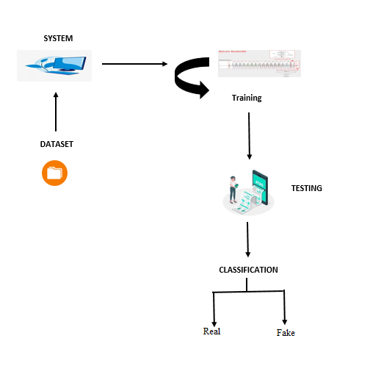
System Architecture

Slide 15
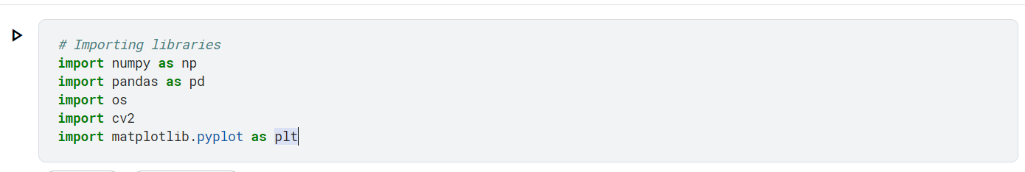
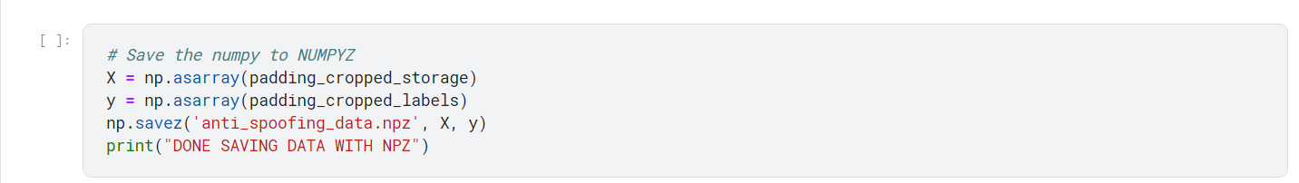
Implementation(Sample Code)
Import libraries:
Saving the data in NPZ file:

Slide 16
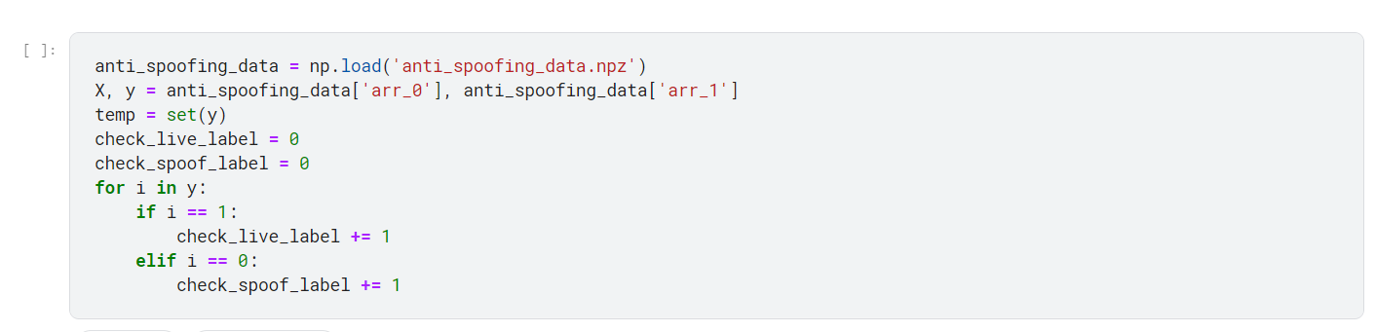
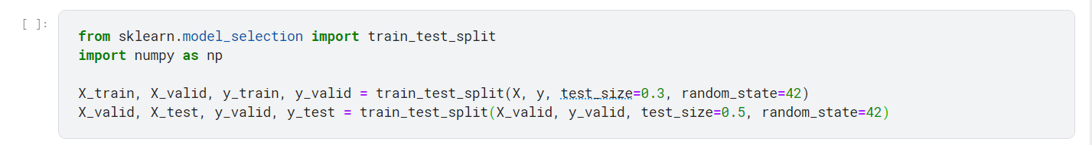
Contd…
Checking the number of Live Samples and Spoof Samples after extracting
SKlearn used for Splitting Training and Testing dataset:

Slide 17
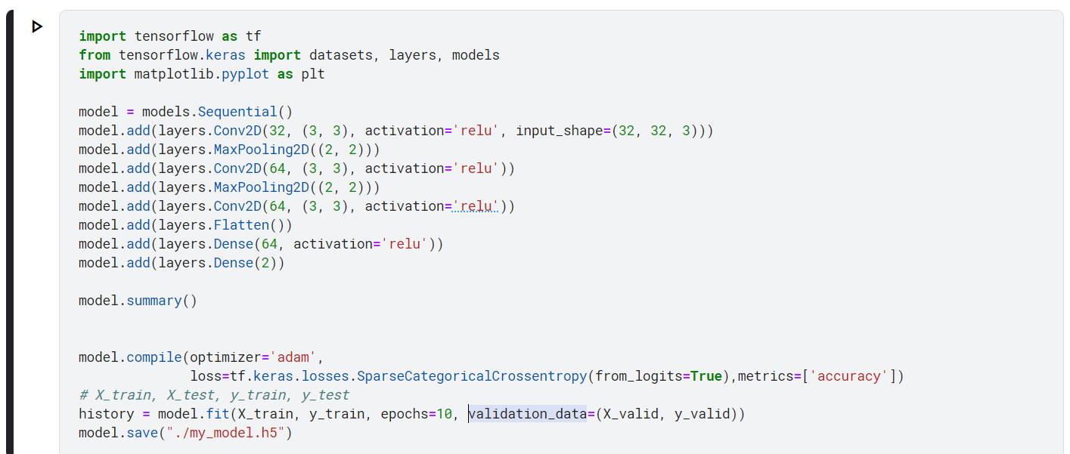
Contd…
Build a simple CNN Model for training, validating and testing

Slide 18

Result
The following image is Home page:

Slide 19

Contd…
This page describes the project briefly.

Slide 20

Contd…
This is the prediction page where you can run the algorithm.

Slide 21

Contd…
OUTPUT:

Slide 22
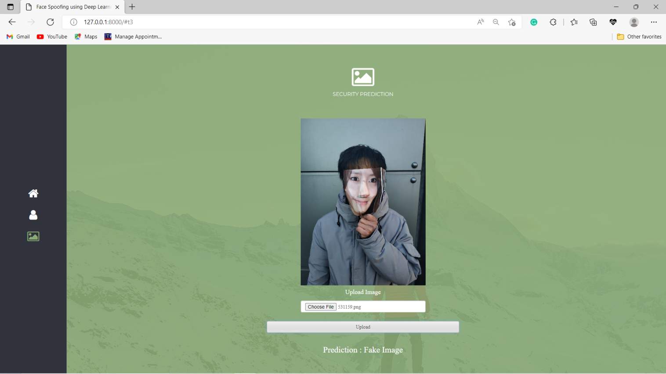
Contd…

Slide 23
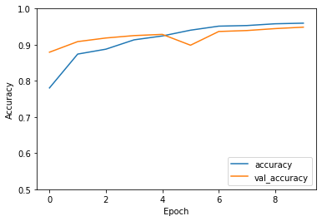
Graph
The graphical representation of our model is as follows:

Slide 24
Conclusion
We proposed a Convolution Neural Network framework for face anti-spoofing problem, which is inspired by the philosophy used by humans to determine whether a presented face example is genuine or not, namely, to look at the example globally first and then carefully observe the local regions to gain more discriminative information (CNN).
An end-to-end learning approach, where the input to a CNN is a face image and the output is class probability has been proposed.
Specifically, we use deep learning to mimic the behaviour of discovering face-spoofing-related information from image sub-patches.
Experimental results clearly demonstrate the effectiveness of the proposed CNN architecture with 95% percent accuracy.

Slide 25
References
H.Li, W.Li, H.Cao, S.Wang, F.Huang, and A.C.Kot, “Unsupervised domain adaptation for face anti-spoofing”
R.Nosaka, Y.Ohkawa, and K.Fukui, “Feature extraction based on co-occurrence of adjacent local binary patterns”
I.Chingovska, A.Anjos, and S.Marcel, “On the effectiveness of local binary patterns in face anti-spoofing”
Dataset :
https://www.kaggle.com/datasets/attentionlayer241/celeba-spoof-for-face-antispoofing

Slide 26
Thank You!!!

